Slide 1
Recommendation and Information Retrieval:
Two sides of the same coin?
Prof.dr.ir. Arjen P. de Vries
arjen@acm.org
CWI, TU Delft, Spinque

Slide 2
Outline
Recommendation Systems
  Collaborative Filtering (CF)
Probabilistic approaches
  Language modelling for Information Retrieval
  Language modelling for log-based CF
  Brief: adaptations for rating-based CF
Vector Space Model (“Back to the Future”)
  User and item spaces, orthonormal bases and “the spectral theorem”

Slide 3
Recommendation
Informally:
  Search for information “without a query”
Three types:
  Content-based recommendation
  Collaborative filtering (CF)
    Memory-based
    Model-based
  Hybrid approaches

Slide 4
Recommendation
Informally:
  Search for information “without a query”
Three types:
  Content-based recommendation
  Collaborative filtering
    Memory-based
    Model-based
  Hybrid approaches
Today’s focus!

Slide 5
Collaborative Filtering
Collaborative filtering (originally introduced by Patti Maes as “social information filtering”)
  1. Compare user judgments
  2. Recommend differences between similar users
Leading principle:
People’s tastes are not randomly distributed
  A.k.a. “You are what you buy”

Slide 6

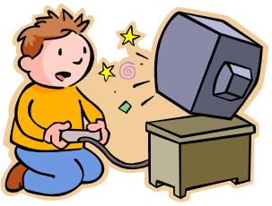


User-based CF
Similarity Measure
Notes:
Recommendation can
be obtained by looking at top-N similar peers' user preferences.
More similar a peer, more chance its liked content will get
recommended.

Slide 7
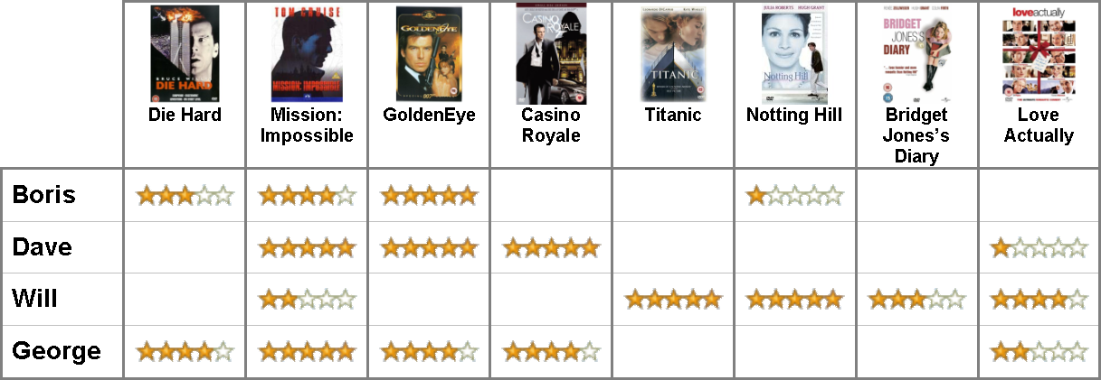
Rating Matrix

Slide 8
Users

Slide 9

Items

Slide 10
Rating

Slide 11
User Profile

Slide 12
Item Profile

Slide 13
Unknown rating

Slide 14
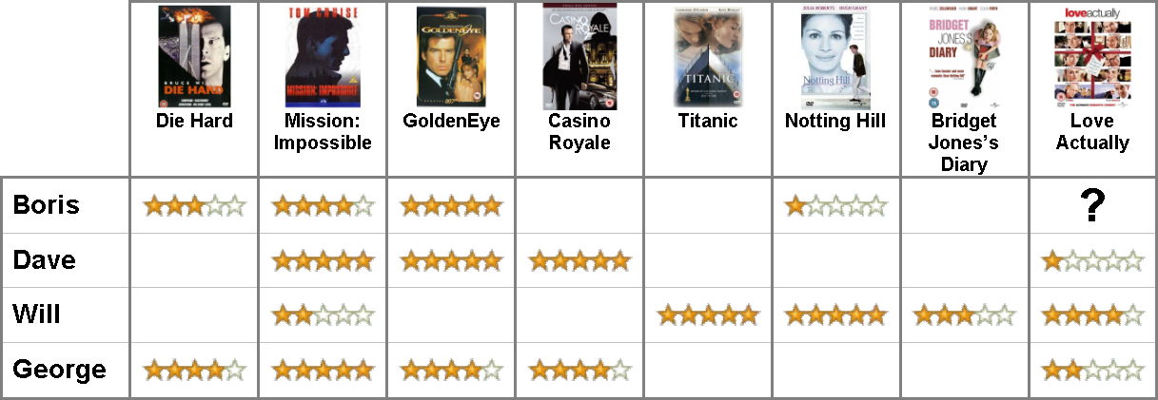
Objective
If user Boris watched Love Actually, how would he rate it?

Slide 15
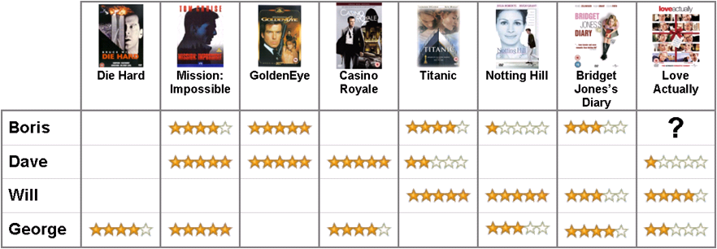
Prediction

Slide 16
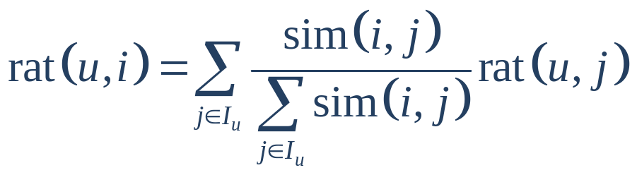
Collaborative Filtering
Standard item-based formulation (Adomavicius & Tuzhilin 2005)

Slide 17
Collaborative Filtering
Benefits over content-based approach
  Overcomes problems with finding suitable features to represent e.g. art, music
  Serendipity
  Implicit mechanism for qualitative aspects like style
Problems: large groups, broad domains

Slide 18
Prediction vs. Ranking
Original formulations focused on modelling the users’ item ratings: rating prediction
  Evaluation of algorithms (e.g., Netflix prize) by Mean Absolute Error (MAE) or Root Mean Square Error (RMSE) between predicted and actual ratings
However, for the end user, the ranking of recommended items is the essential problem: relevance ranking
  Evaluation by precision at fixed rank (P@N)

Slide 19
Relevance Ranking
Core problem of Information Retrieval!

Slide 20
Generative Model
A statistical model for generating data
  Probability distribution over samples in a given ‘language’
M
P ( | M )
= P ( | M )
P ( | M, )
P ( | M, )
P ( | M, )
© Victor Lavrenko, Aug. 2002

Slide 21
Unigram models etc.
P ( )
Unigram Models
N-gram Models (here, N=2)
= P ( )
P ( | )
P ( | )
P ( | )
P ( ) P ( ) P ( ) P ( )
P ( ) P ( | ) P ( | ) P ( | )
© Victor Lavrenko, Aug. 2002

Slide 22
Fundamental Problem
Usually we don’t know the model M
  But have a sample representative of that model
First estimate a model from a sample
Then compute the observation probability
P ( | M ( ) )
M
© Victor Lavrenko, Aug. 2002

Slide 23
Language Models…
Unigram Language Models (LM)
  Urn metaphor
P( ) ~ P ( ) P ( ) P ( ) P ( )
= 4/9 * 2/9 * 4/9 * 3/9
© Victor Lavrenko, Aug. 2002

Slide 24
… for Information Retrieval
Rank models (documents) by probability of generating the query:
Q:
P( | ) = 4/9 * 2/9 * 4/9 * 3/9 = 96/9
P( | ) = 3/9 * 3/9 * 3/9 * 3/9 = 81/9
P( | ) = 2/9 * 3/9 * 2/9 * 4/9 = 48/9
P( | ) = 2/9 * 5/9 * 2/9 * 2/9 = 40/9

Slide 25
Zero-frequency Problem
Suppose some event not in our example
  Model will assign zero probability to that event
  And to any set of events involving the unseen event
Happens frequently in natural language text, and it is incorrect to infer zero probabilities
  Especially when dealing with incomplete samples
?

Slide 26
Smoothing
Idea:
Shift part of probability mass to unseen events
Interpolate document-based model with a background model (of “general English”)
  Reflects expected frequency of events
  Plays role of IDF
  λ + (1-λ)

Slide 27
Relevance Ranking
Core problem of Information Retrieval!
  Question arising naturally:
  Are CF and IR, from a modelling perspective, really two different problems then?
Jun Wang, Arjen P. de Vries, Marcel JT Reinders, A User-Item Relevance Model for Log-Based Collaborative Filtering, ECIR 2006

Slide 28
User-Item Relevance Models
Idea: apply the probabilistic retrieval model to CF

Slide 29
User-Item Relevance Models
Idea: apply the probabilistic retrieval model to CF
Treat user profile as query and answer the following question:
  “ What is the probability that this item is relevant to this user, given his or her profile”
Hereto, apply the language modelling approach to IR as a formal model to compute the user-item relevance

Slide 30
Implicit or explicit relevance?
Rating-based CF:
  Users explicitly rate “items”
    We use “items” to represent contents (movie, music, etc.)
Log-based CF:
  User profiles are gathered by logging the interactions. Music play-list, web surf log, etc.

Slide 31
User-Item Relevance Models
Existing User-based/Item-based approaches
  Heuristic implementations of “word-of-mouth”
  Unclear how to best deal with the sparse data!
User-Item Relevance Models
  Give probabilistic justification
  Integrate smoothing to tackle the problem of sparsity

Slide 32
User-Item Relevance Models
User Representation
Target Item
Other users who liked
the target item
Relevance
?
Other Items that
the target user liked
Target User
Item Representation

Slide 33
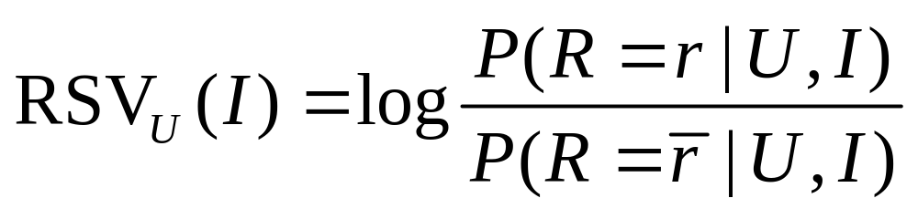
User-Item Relevance Models
We introduce the following random variables:
Using the probabilistic model to IR, we rank items by their log odds of relevancy:

Slide 34

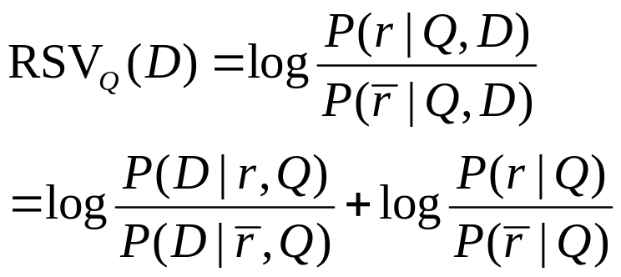
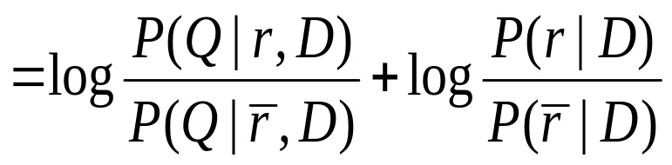

User-Item Relevance Model
[Lafferty, Zhai 02]
D: Document; Q: Query
: relevance
The Robertson-Sparck Jones Models
Or:
The Language Models

Slide 35
Item Representation
im?
Target Item
Relevance
{ib}
uk
Query Items:
other Items that
the target user liked
Target User
Item Representation

Slide 36
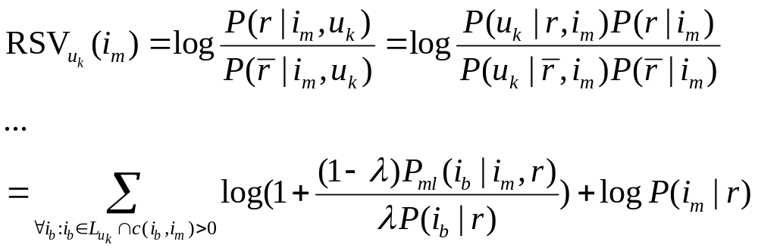
User-Item Relevance Models
Item representation
  Use items that I liked to represent target user
  Assume the item “ratings” are independent
  Linear interpolation smoothing to address sparsity

Slide 37
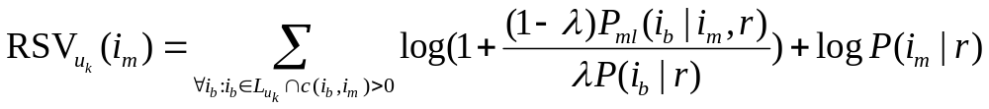
User-Item Relevance Models
Probabilistic justification of Item-based CF
  The RSV of a target item is the combination of its popularity and its co-occurrence with items (query items) that the target user liked.
Co-occurrence
popularity

Slide 38
User-Item Relevance Models
Probabilistic justification of Item-based CF
  The RSV of a target item is the combination of its popularity and its co-occurrence with items (query items) that the target user liked
    Item co-occurrence should be emphasized if more users express interest in both target & query item
    Item co-occurrence should be suppressed when the popularity of the query item is high
Co-occurrence between target item and query item
Popularity of query item

Slide 39
User Representation
im?
{ub}
Target Item
Other users who liked
the target item
Relevance
uk
Target User

Slide 40
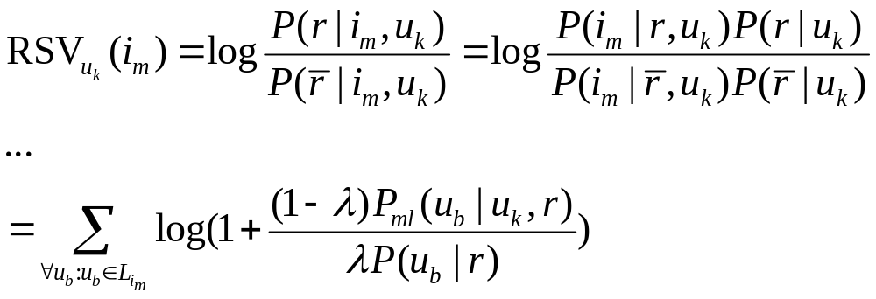
User-Item Relevance Models
User representation
  Represent target item by users who like it
  Assume the user profiles are independent
  Linear interpolation smoothing to address sparsity

Slide 41
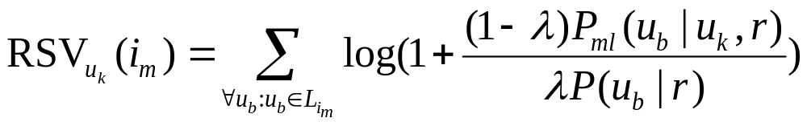
User-Item Relevance Models
Probabilistic justification of User-based CF
  The RSV of a target item towards a target user is calculated by the target user’s co-occurrence with other users who liked the target item
    User co-occurrence is emphasized if more items liked by target user are also liked by the other user
    User co-occurrence should be suppressed when this user liked many items
Co-occurrence between the target user and the other users
Popularity of the other users

Slide 42
Empirical Results
Data Set:
  Music play-lists from audioscrobbler.com
  428 users and 516 items
  80% users as training set and 20% users as test set.
  Half of items in test set as ground truth, others as user profiles
Measurement
  Recommendation Precision:
  (num of corrected items)/(num. of recommended)
  Averaged over 5 runs
  Compared with the suggestion lib developed in GroupLens

Slide 43
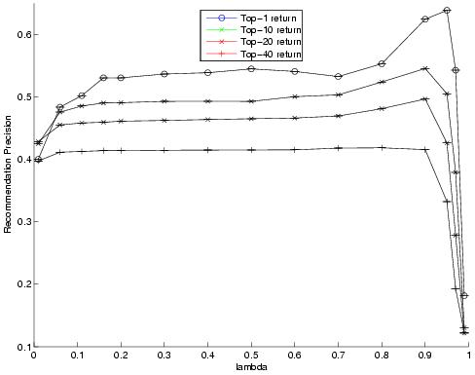
P@N vs. lambda

Slide 44
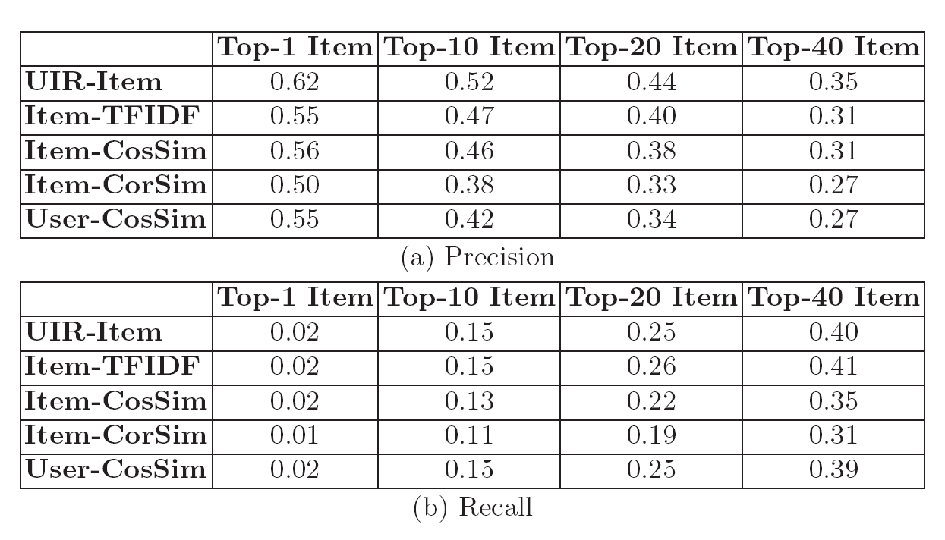
Effectiveness (P@N)

Slide 45
So far…
User-Item relevance models
  Give a probabilistic justification for CF
  Deal with the problem of sparsity
  Provide state-of-art performance

Slide 46
Rating Prediction?
Previous log-based CF method predicts nor uses rating information
  Ranks items solely by usage frequency
  Appropriate for, e.g., music recommendation in a service like Spotify or personalised TV

Slide 47




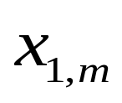


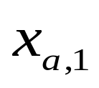

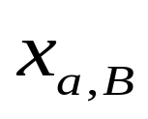

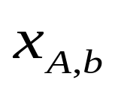
…
…
…
…

Slide 48

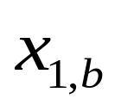
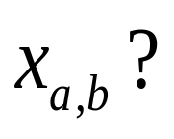
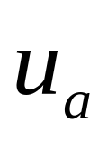
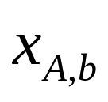
…
…
Sorted Item Similarity
Rating Prediction
SIR
Unknown Rating

Slide 49


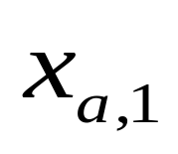

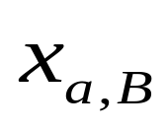
…
Rating Prediction
Sorted User Similarity
…
SUR
Unknown Rating

Slide 50
Sparseness
Whether you choose SIR or SUR, in many cases, the neighborhood extends to include “not-so-similar” users and/or items
Idea:
Take into considerations the similar item ratings made by similar users as extra source for prediction
Jun Wang, Arjen P. de Vries, Marcel JT Reinders, Unifying user-based and item-based collaborative filtering approaches by similarity fusion, SIGIR 2006

Slide 51


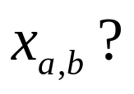
…
…
Sorted Item Similarity
…
Rating Prediction
Rating Prediction
Sorted User Similarity
SUIR
SUR
SIR
…
Unknown Rating

Slide 52

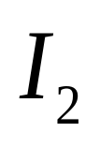
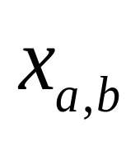
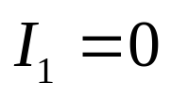
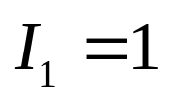
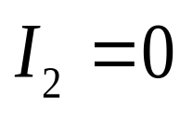
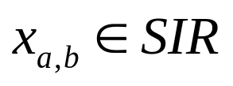
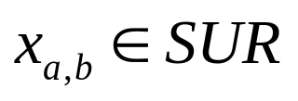
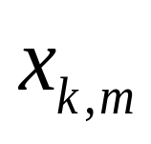
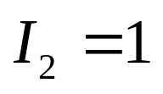
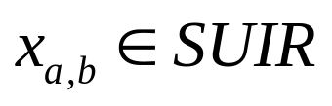
Similarity Fusion

Slide 53
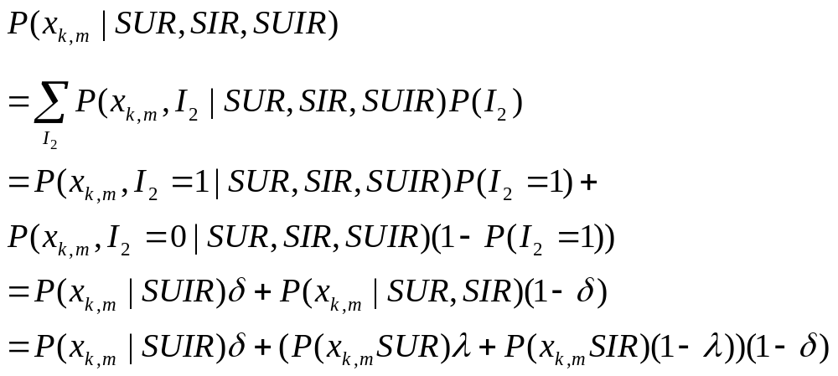
Sketch of Derivation
See SIGIR 2006 paper for more details

Slide 54
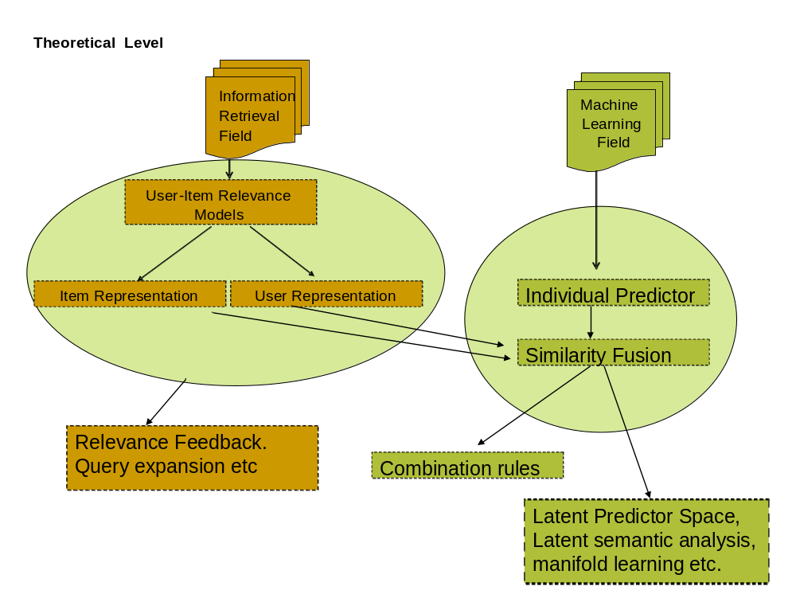

Slide 55
Remarks
SIGIR 2006 paper estimates probabilities directly from the similarity distance given between users and items
TOIS 2008 paper below applies Parzen window kernel density estimation to the rating data itself, to give a full probabilistic derivation
  Shows how the “kernel trick” let’s us generalize the distance measure; such that a cosine (projection) kernel (length-normalized dot product) can be chosen, while keeping Gaussian kernel Parzen windows
Jun Wang, Arjen P. de Vries, and Marcel J. T. Reinders. Unified relevance models for rating prediction in collaborative filtering. ACM TOIS 26 (3), June 2008

Slide 56
Relevance Feedback
Relevance Models for query expansion in IR
  Language model estimated from known relevant or from top-k documents (Pseudo-RFB)
  Expand query with terms generated by the LM
Application to recommendation
  User profile used to identify neighbourhood; a Relevance Model estimated from that neighbourhood used to expand the profile
  Deploy probabilistic clustering method PPC to construct the neighbourhood
  Very good empirical results on P@N
Javier Parapar, Alejandro Bellogín, Pablo Castells, Álvaro Barreiro. Relevance-Based Language Modelling for Recommender Systems.Information Processing & Management 49 (4), pp. 966-980

Slide 57
CF =~ IR?
Follow-up question:
Can we go beyond “model level” equivalences observed so far, and actually cast the CF problem such that we can use the full IR machinery?
Alejandro Bellogín, Jun Wang, and Pablo Castells.Text Retrieval Methods for Item Ranking in Collaborative Filtering. ECIR 2011

Slide 58
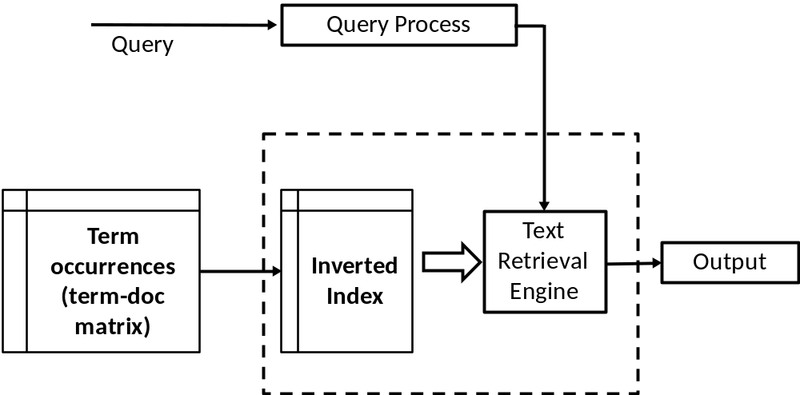
IR System

Slide 59
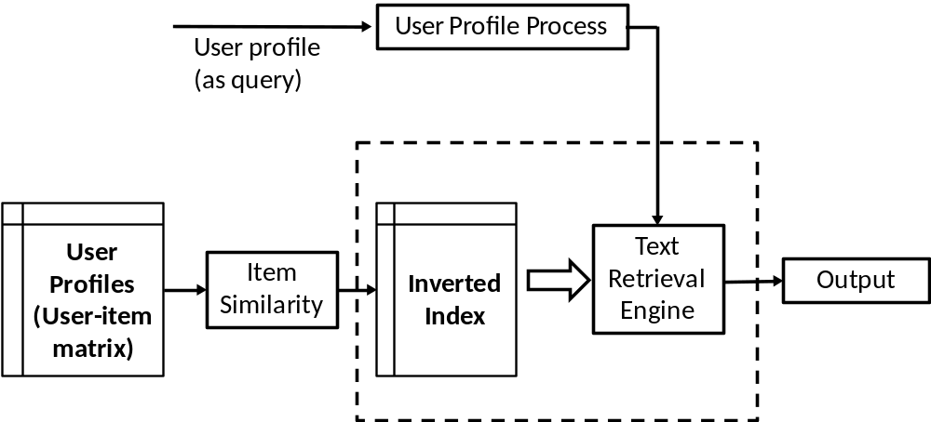
CF RecSys?!

Slide 60
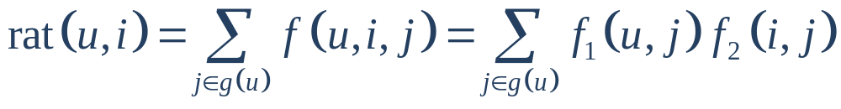
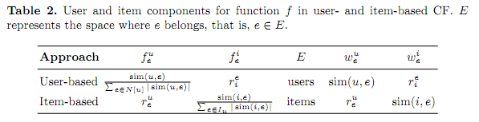
Collaborative Filtering
Standard item-based formulation
More general

Slide 61
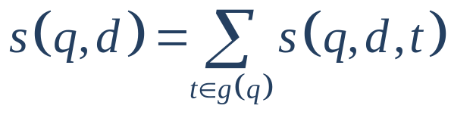
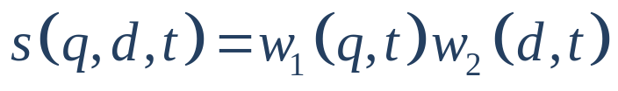
Text Retrieval
In (Metzler & Zaragoza, 2009)
  In particular: factored form
Notes:
Recently they introduce a general framework for the term weighting problem

Slide 62
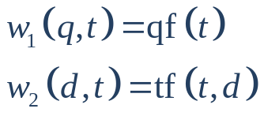
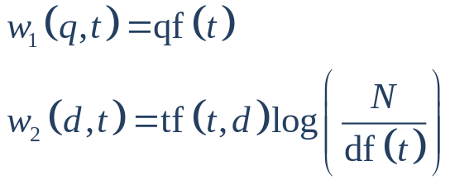
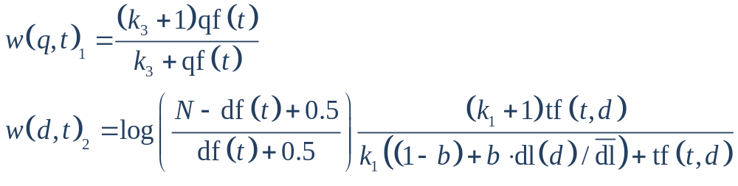
Text Retrieval
Examples
  TF:
  TF-IDF:
  BM25:

Slide 63
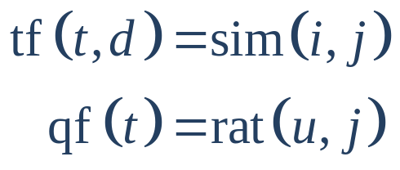
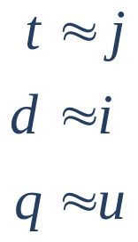
IR =~ CF?
In item-based Collaborative Filtering
Apply different models
  With different normalizations and norms: s_{qd}, L₁ and L₂
s_{qd} |  | Document
 |  | No norm | Norm ( /|D|)
Query | No norm | s₀₀ | s₀₁
 | Norm ( /|Q|) | s₁₀ | s₁₁
Notes:
If we take … as …, we obtain equivalent scoring functions

Slide 64
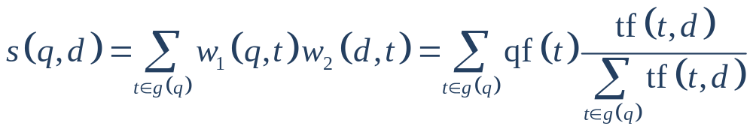
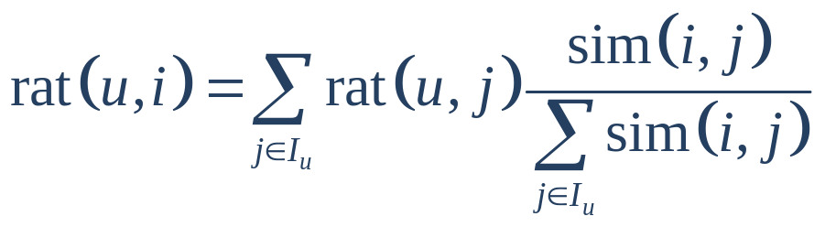

IR =~ CF!
TF L1 s01 is equivalent to item-based CF

Slide 65

Empirical Results
Movielens 1M
  Movielens100k: comparable results
TF L1 s01 equivalent to item-based CF (baseline)

Slide 66
Vector Space Model
Challenge: get users and items in common space
  Intuition: the shared “words” are missing, which in IR directly relate documents to queries
  Two extreme settings:
    Project items into a space with dimensionality of the number of items
    Project users into a space with dimensionality of the number of users
A. Bellogín, J. Wang, P. Castells. Bridging Memory-Based Collaborative Filtering and Text Retrieval.
Information Retrieval (to appear)

Slide 67




Item Space
User
Item
Rank
Predict rate

Slide 68



User space
User
Item
Rank
Predict rate

Slide 69



Linear Algebra
Users and items in shared orthonormal space:
Consider covariance matrix
Spectral theorem now states that an orthonormal basis of eigenvectors exists

Slide 70


Linear Algebra
Use this basis to represent items and users:
The dot product then has a remarkable form (of the IR models discussed):

Slide 71
Subspaces…
Number of items (n) vs. number of users (m):
  If n < m, a linear dependency must exist between users in terms of the item space components
  In this case, it has been known empirically that item-based algorithms tend to perform better
    Dimension of sub-space key for the performance of the algorithm?
    ~ better estimation (more data per item) in the probabilistic versions

Slide 72

Subspaces…
Matrix Factorization methods are captured by assuming a lower-dimensionality space to project items and users into (usually considered “model-based” rather than “memory-based”)
~ Latent Semantic Indexing (a VSM method replicated as pLSA and variants)

Slide 73

Ratings into Inverted File
Note: distribution of item occurrences not Zipfian like text, so existing implementations (including choice of compression etc.) may be sub-optimal for CF runtime performance

Slide 74

Weighting schemes

Slide 75

Empirical results 1M

Slide 76

Empirical results 10M

Slide 77

Rating prediction

Slide 78
Concluding Remarks
The probabilistic models are elegant (often deploying impressive maths), but what do they really add in understanding IR & CF – i.e., beyond the (often claimed to be “ad-hoc”) approaches of the VSM?

Slide 79
Concluding Remarks
Clearly, the models in CF & IR are closely related
Should these then really be studied in two different (albeit overlapping) communities, RecSys vs. SIGIR?

Slide 80
References
Adomavicius, G., Tuzhilin, A.: Toward the next generation of recommender systems: a survey of the state-of-the-art and possible extensions. IEEE TKDE 17(6), 734-749 (2005)
Alejandro Bellogín, Jun Wang, and Pablo Castells.Text Retrieval Methods for Item Ranking in Collaborative Filtering. ECIR 2011.
Metzler, D., Zaragoza, H.: Semi-parametric and non-parametric term weighting for information retrieval. ECIR 2009.
Javier Parapar, Alejandro Bellogín, Pablo Castells, Álvaro Barreiro. Relevance-Based Language Modelling for Recommender Systems.Information Processing & Management 49 (4), pp. 966-980
A. Bellogín, J. Wang, P. Castells. Bridging Memory-Based Collaborative Filtering and Text Retrieval.Information Retrieval (to appear)
Jun Wang, Arjen P. de Vries, Marcel JT Reinders, Unifying user-based and item-based collaborative filtering approaches by similarity fusion, SIGIR 2006
Jun Wang, Arjen P. de Vries, Marcel JT Reinders, A User-Item Relevance Model for Log-Based Collaborative Filtering, ECIR 2006
Jun Wang, Arjen P. de Vries, and Marcel J. T. Reinders. Unified relevance models for rating prediction in collaborative filtering. ACM TOIS 26 (3), June 2008.
Jun Wang, Stephen Robertson, Arjen P. de Vries, and Marcel J.T. Reinders. Probabilistic relevance ranking for collaborative filtering. Information Retrieval 11 (6):477-497, 2008

Slide 81
Thanks
Alejandro Bellogín
Jun Wang
Thijs Westerveld
Victor Lavrenko

